Slide 1
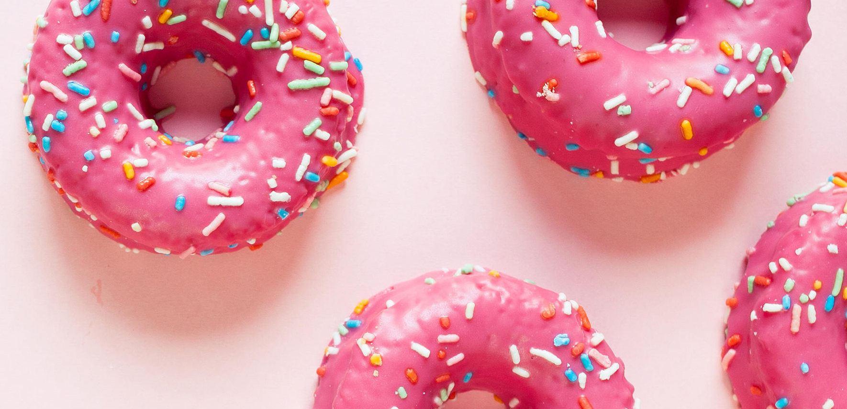






Want to See More?
Home
Story
Menu
Contact

Slide 2
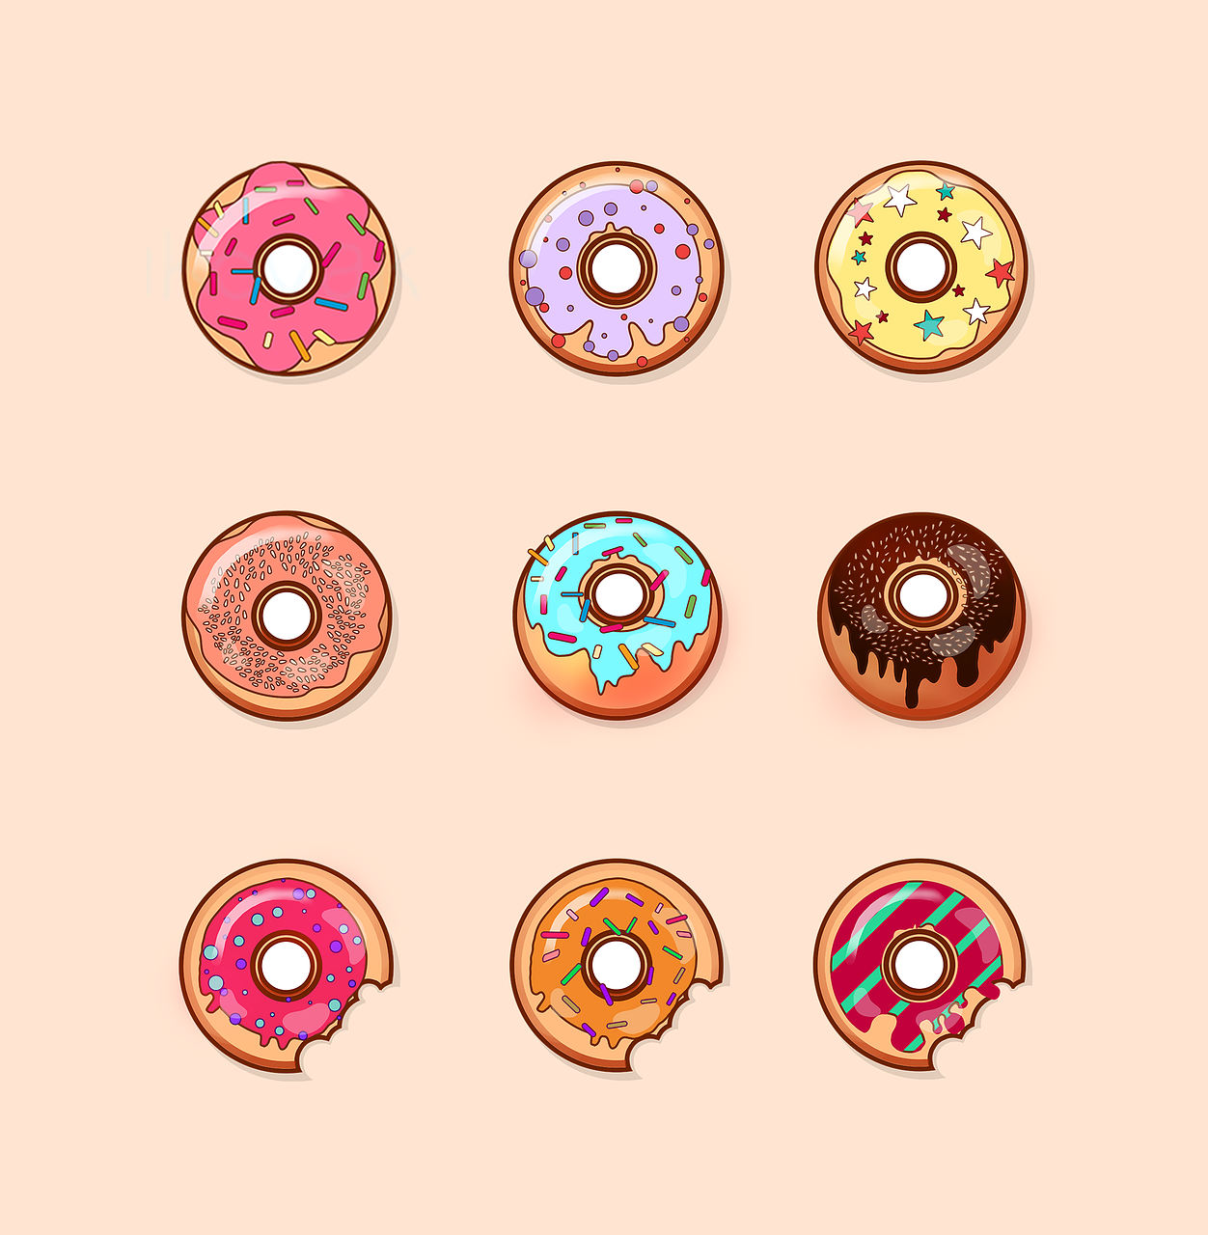

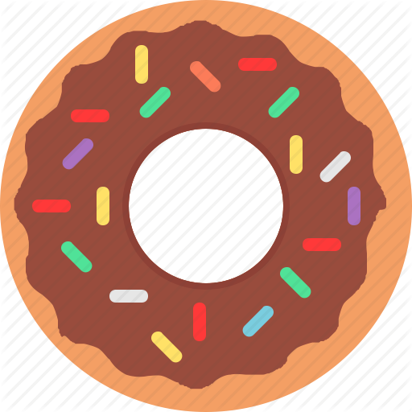

Donut Delights Story
Donut Delights was started in 1971 by Melvin Furballski. In 1970 he landed in New York City and by chance he found an open seat on a bus heading west. When an unexpected mechanical failure forced a three day delay in Champaign, Illinois, Furballski decided to stay and with only one hundred dollars to his name, he transformed an abandoned bread shop into C-U’s finest breakfast and coffee shop!
Back to Home
©Donut Delights Inc. All right reserved.

Slide 3
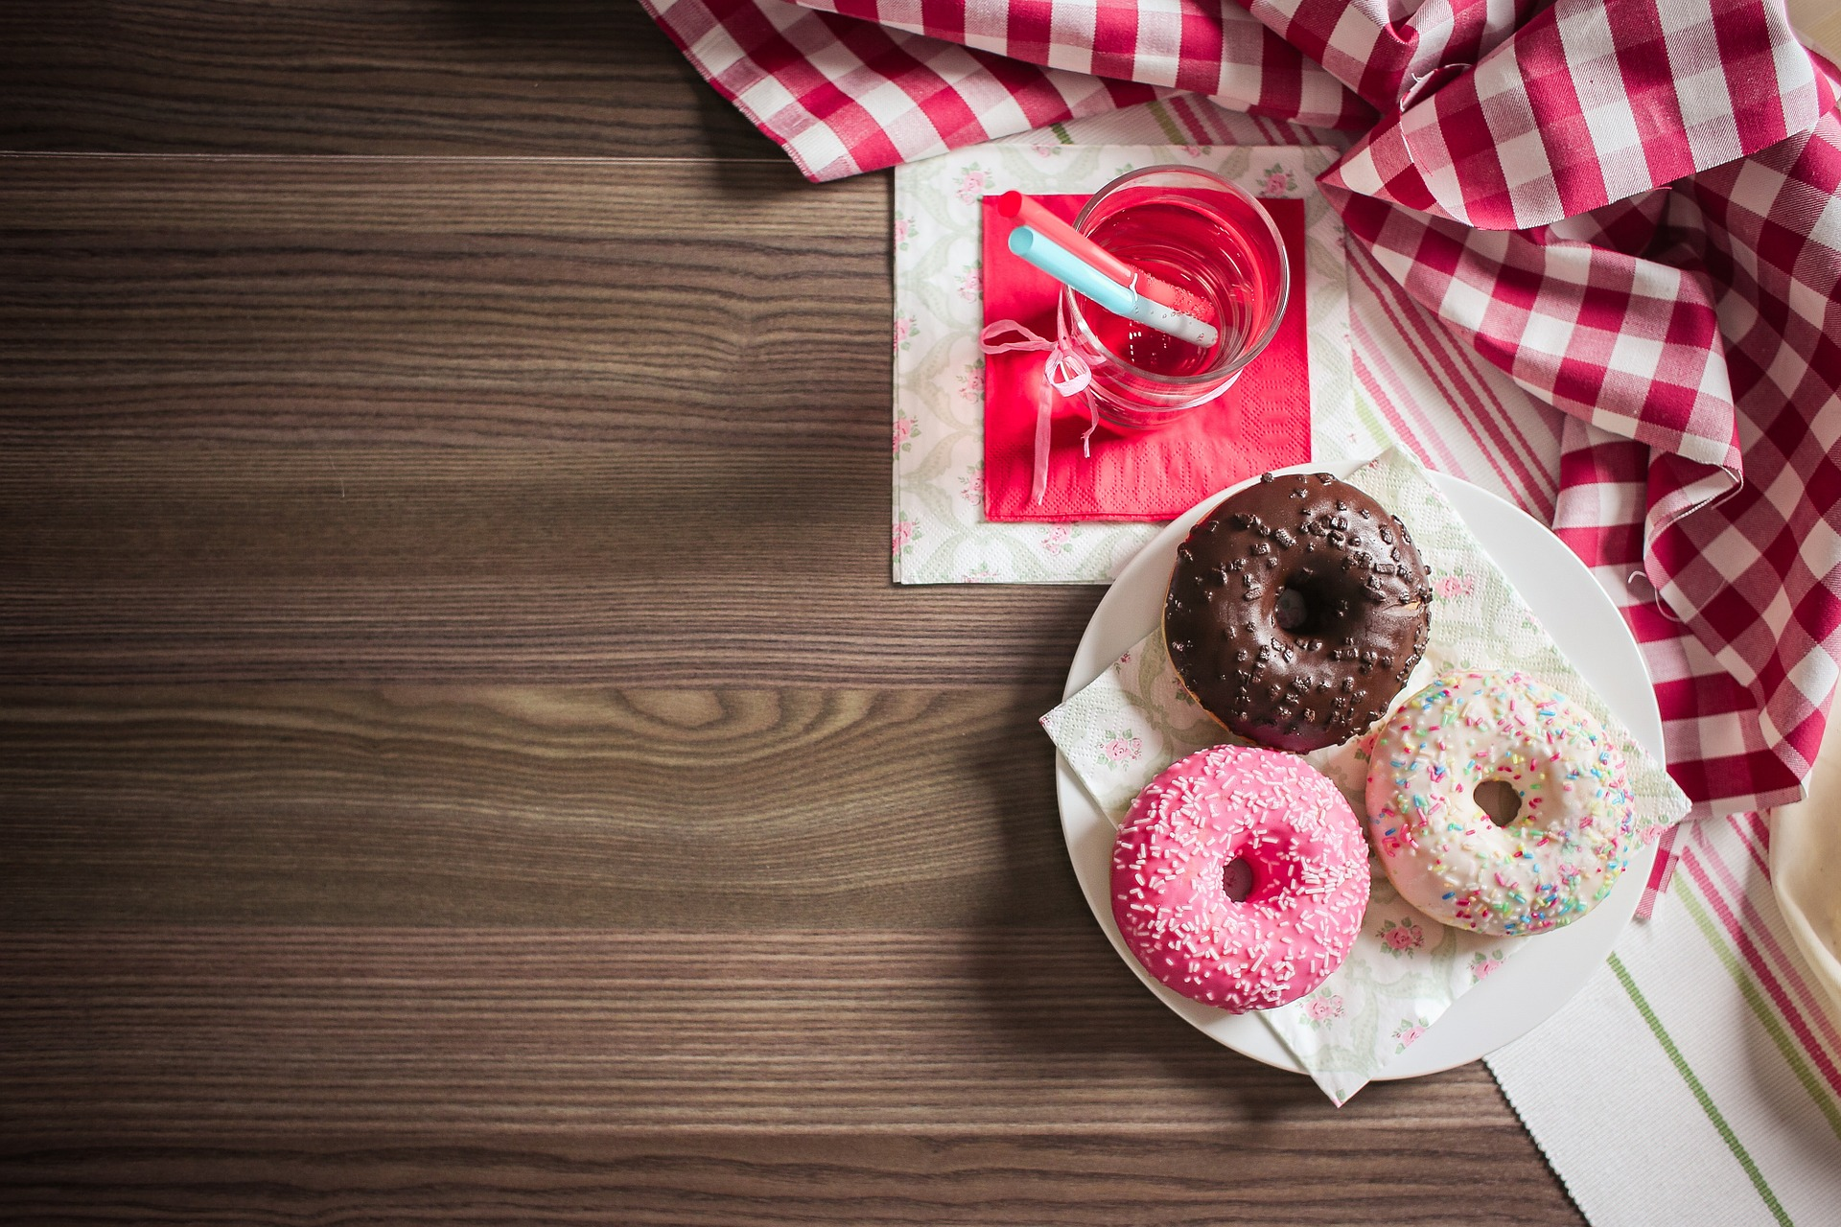
Regular Donut: chocolate frosted, vanilla frosted, boston cream, jelly filled, cream filled, glazed, chocolate glazed, marble twist, sugar raised, plain donut, plain cruller, honey wheat, jelly puff, cream puff, coffee roll
Fancy Donut fancy donuts: bow tie, éclair, apple turnover, fancy coffee roll
Top sellers:
Pistachio Pinwheels
Boston Cream delights
Chocolate confetti
Marshmallow Mayhems
French twists
Bulls Horns
Back to Home

Slide 4
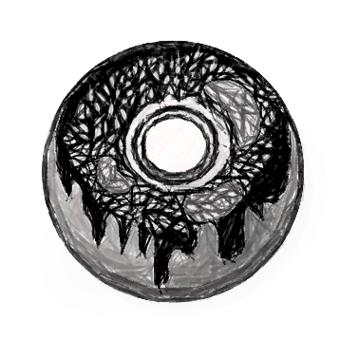
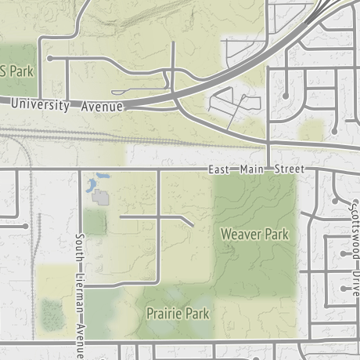
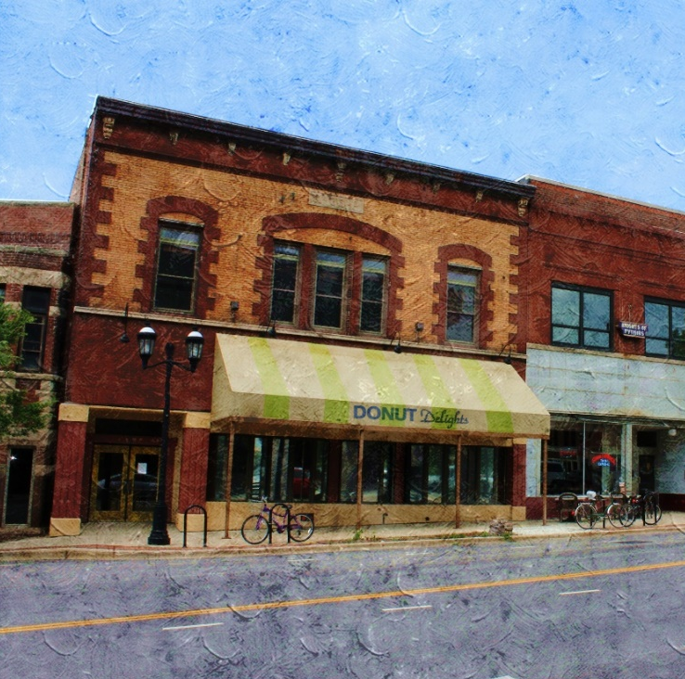

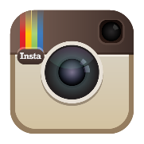


Contact Us:
Back to Home
“Subscribe to our newsletter for the latest on our seasonal offerings and special events
2112 main street Urbana
Illinois 61801
Subscribe to our newsletter for the latest on our seasonal offerings and special events：
Email:_________________________________________Name:________________________________________
©Donut Delights Inc. All right reserved.

